Slide 1
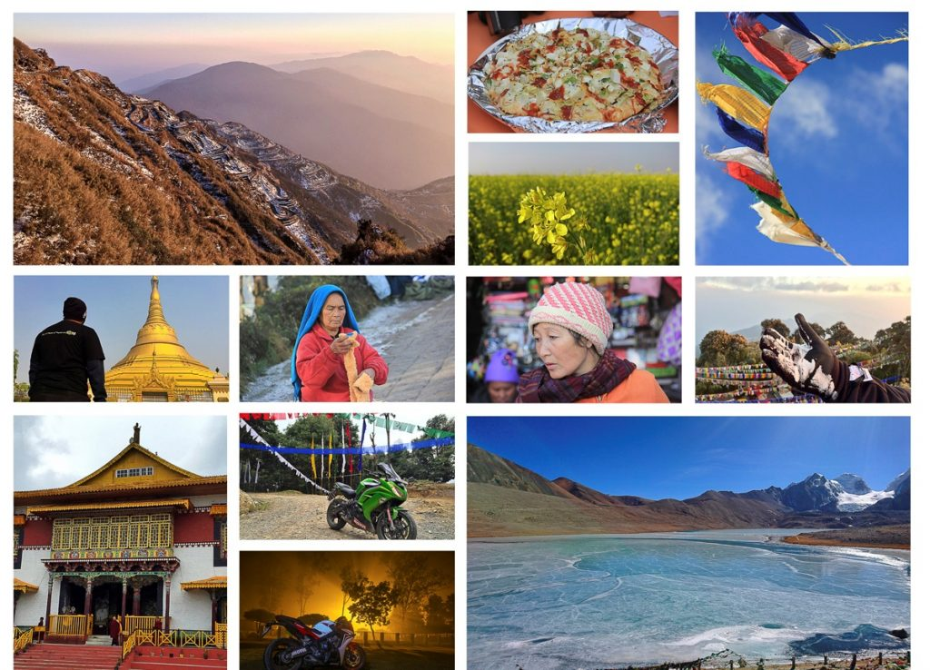
Buddhism $ monasteries
Chitranshi bansal
10-A
41
ENGLISH

Slide 2
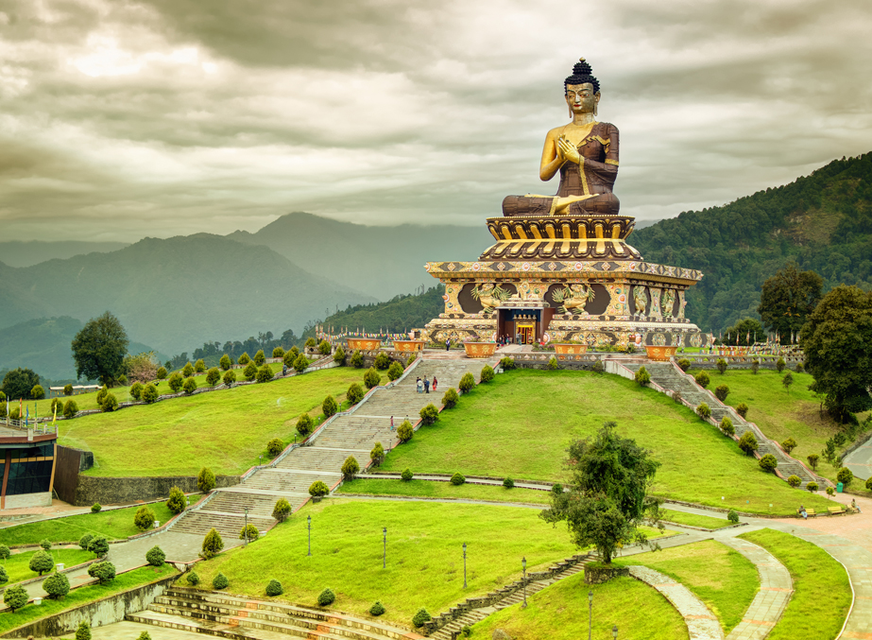
HISTORY OF SIKKIM

Slide 3
Little is known of Sikkim’s history prior to the 17th century.
The state’s name is derived from the Limbu words su him, meaning “new house.”
The Lepcha were early inhabitants of the region, apparently assimilating the Naong, Chang, Mon, and other tribes.
The Bhutia began entering the area from Tibet in the 14th century.
When the kingdom of Sikkim was established in 1642, Phuntsog Namgyal, the first chogyal (temporal and spiritual king), came from the Bhutia community.
The Namgyal dynasty ruled Sikkim until 1975.
Sikkim fought a series of territorial wars with both Bhutan and Nepal beginning in the mid-18th century, and Nepal subsequently came to occupy parts of western Sikkim and the submontane Tarai region to the south. It was during this period that the largest migration of Nepalese to Sikkim began.
In 1816 these territories were restored to Sikkim by the British in return for its support during the Anglo-Nepalese War (1814–16), but by 1817 Sikkim had become a de facto protectorate of Britain.
The treaty established Sikkim as a princely state under British paramountcy (though leaving the issue of sovereignty undefined), and the British were given rights of free trade and of road making through Sikkim to Tibet.

Slide 4
After India attained independence in 1947, political parties began to be formed in Sikkim for the first time.
Prior to Indian independence, Jawaharlal Nehru, as the Vice President of the Executive Council, pushed through a resolution in the Indian Constituent Assembly to the effect that Sikkim and Bhutan, as Himalayan states, were not 'Indian states' and their future should be negotiated separately.
A standstill agreement was signed in February 1948.
A state council was established in 1953 to allow for constitutional government under the Chogyal.
Despite pressures from an India "bent on annexation", Chogyal Palden Thondup Namgyal was able to preserve autonomy and shape a "model Asian state" where the literacy rate and per capita income were twice as high as neighbouring Nepal, Bhutan and India.
Meanwhile, the Sikkim National Congress demanded fresh elections and greater representation for Nepalis in Sikkim. People marched on the palace against the monarchy.
In 1973, anti-royalist riots took place in front of the Chogyal's palace.
India prepared a constitution for Sikkim that was approved by its national assembly in 1974.
In a special referendum held in 1975, more than 97 percent of the electorate voted for the merger of Sikkim with India.
Sikkim became the 22nd state of India on May 16, 1975.

Slide 5
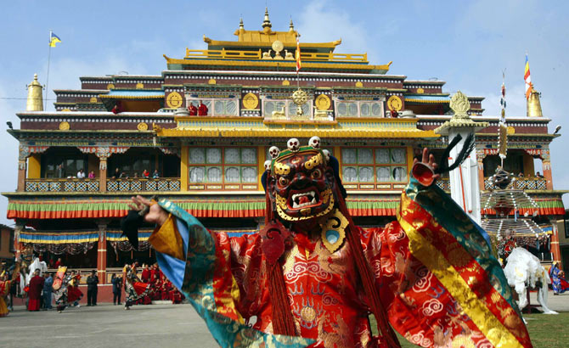
SIKKIM’S CULTURAL LIFE

Slide 6
Sikkim’s cultural life, though showing strong Tibetan influences, retains a character derived from the various tribes of Sikkim and their pre-Buddhist customs.
The most important festival of the year is the two-day Phanglhapsol festival in August or September, in which masked dancers perform in honour of Kanchenjunga, the presiding deity.
The Namgyal Institute of Tibetology (1958), in Gangtok, has one of the largest collections of Tibetan books in the world.
Many monasteries are repositories of wall paintings, thang-kas (religious paintings mounted on brocade), bronze images, and other artworks.
Sikkim's Nepalese majority celebrate all major Hindu festivals, including Tihar (Diwali) and Dashain (Dashera). Traditional local festivals, such as Maghe Sankranti, Sakela, Chasok Tangnam and Bhimsen Puja, are popular.
Losar, Saga Dawa, Lhabab Duechen, Drupka Teshi and Bhumchu are among the Buddhist festivals celebrated in Sikkim. During the Losar (Tibetan New Year), most offices and educational institutions are closed for a week.
Sikkimese Muslims celebrate Eid ul-Fitr and Muharram.Christmas has been promoted in Gangtok to attract tourists during the off-season.
Western rock music and Indian pop have gained a wide following in Sikkim. Nepali rock and Lepcha music are also popular.[135] Sikkim's most popular sports are football and cricket, although hang gliding and river rafting have grown popular as part of the tourism industry.

Slide 7
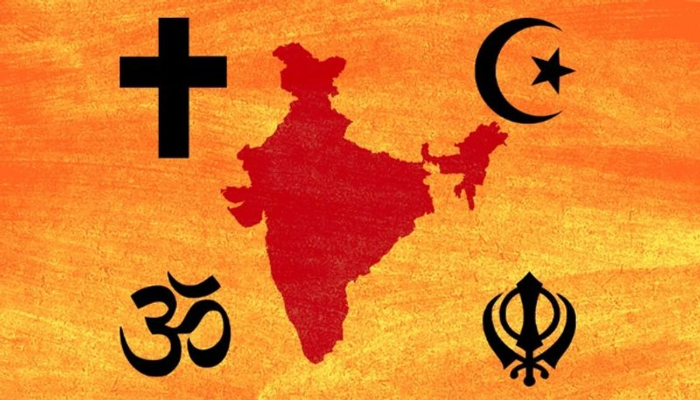

RELIGION IN SIKKIM

Slide 8
According to the 2011 census, 57.8% follow Hinduism, making it the state's majority religion. Buddhism is followed by 27.4% of the population, while Christianity is followed by 9.9%.There are many Hindu temples throughout the state.
Vajrayana Buddhism, which accounts for 27.3 percent of the population, is Sikkim's second-largest, yet most prominent religion. Prior to Sikkim's becoming a part of the Indian Union, Vajrayana Buddhism was the state religion under the Chogyal. Sikkim has 75 Buddhist monasteries, the oldest dating back to the 1700s. The public and visual aesthetics of Sikkim are executed in shades of Vajrayana Buddhism and Buddhism plays a significant role in public life, even among Sikkim's majority Nepali Hindu population.
Christians in Sikkim are mostly descendants of Lepchas who were converted by British missionaries in the late 19th century, and constitute around 10 percent of the population. As of 2014, the Evangelical Presbyterian Church of Sikkim is the largest Christian denomination in Sikkim. Other religious minorities include Muslims of Bihari ethnicity and Jains, who each account for roughly one percent of the population. The traditional religions of the native Sikkimese account for much of the remainder of the population.
Although tensions between the Lepchas and the Nepalese escalated during the merger of Sikkim with India in the 1970s, there has never been any major degree of communal religious violence, unlike in other Indian states. The traditional religion of the Lepcha people is Mun, an animist practice which coexists with Buddhism and Christianity.

Slide 9
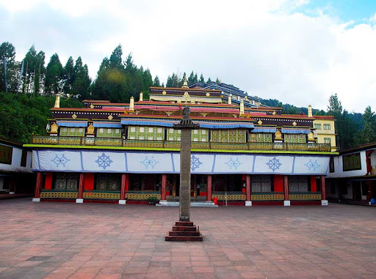
MONASTERIES OF SIKKIM

Slide 10
The beautiful and serene atmosphere of the Monastery is considered as the best place for the meditation or offering prayers to the almighty or seeking some peace from the rat race of the outer world.
One can easily get the feeling of closeness to God within the premises of any monastery.
The numerous monasteries located in Sikkim make this beautiful Himalayan state of India an amazing place for visiting in the search of peace of the mind.
The land of Sikkim is the home to more than 200 big and small monasteries and Gompas. These Buddhism religious places primarily belong to the two main Buddhism sects known as the Nyingmapa Sect and the Kargyupa Sect.
Apart from these two main sects, the monasteries of the few other Buddhism faiths are also present in the Sikkim and these faiths are the Gelugpa faith, Sakyapa faith and the Bon faith.
The most famous monasteries dot the landscape of the Sikkim are the Rumtek monastery in the capital city of Gangtok, Pemayangtse monastery in the city of Pelling in the West Sikkim, Tashiding monastery near the Yuksam city in the West Sikkim, Phodong Monastery near Gangtok, Enchey monastery in Gangtok, Ralang Monastery in Ravangla in South Sikkim, old Sanga-Choeling monastery located near the city of Pelling where you can reach by trekking along with many other monasteries worth visiting while on the Sikkim tour.

Slide 11
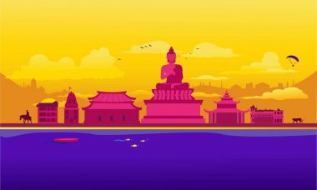
Thank you ☺

